Slide 1
Interpreting Belief Data Various Visualizations of Belief Concepts
Christian Ainscough

Slide 2

America a God-fearing country?
Over recent decades, surveys (e.g., Pew Research and GALLUP) have shown a decline in traditional religious beliefs and affiliation in the U.S., with more Americans identifying as "nones" (atheist, agnostic, or unaffiliated).
So is this true ?
"The greatest trick the devil ever pulled was convincing the world he did not exist". - The Usual Suspects (1995).

Slide 3
So, What did I do ?
What graphs etc did I get python to create ?

Slide 4
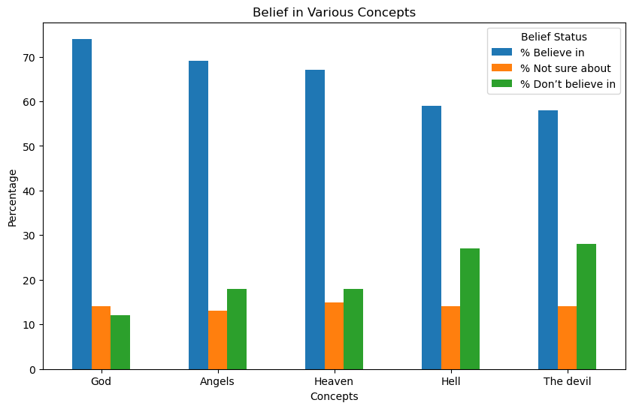
Bar chart

Slide 5

The way to get started is to quit talking and begin doing.
Walt Disney

Slide 6
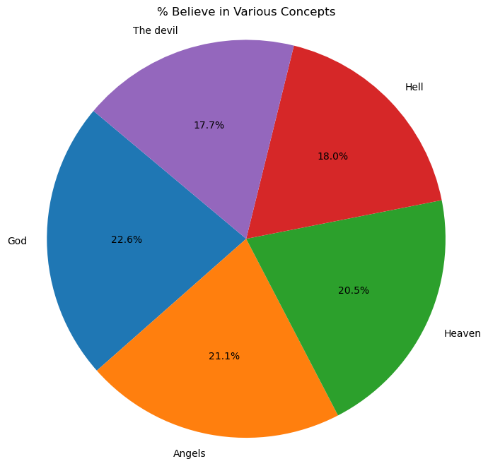
Pie Chart

Slide 7
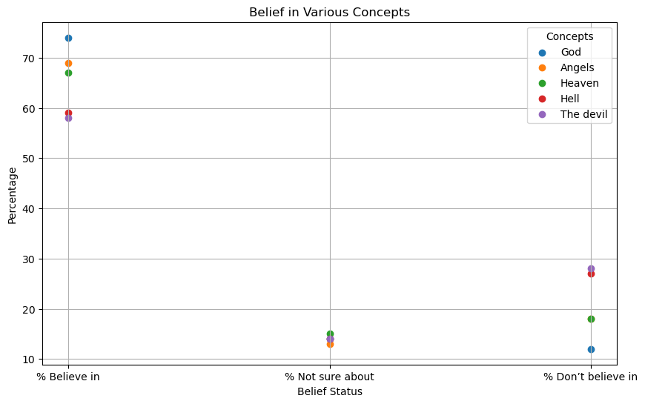
Scatter Chart

Slide 8
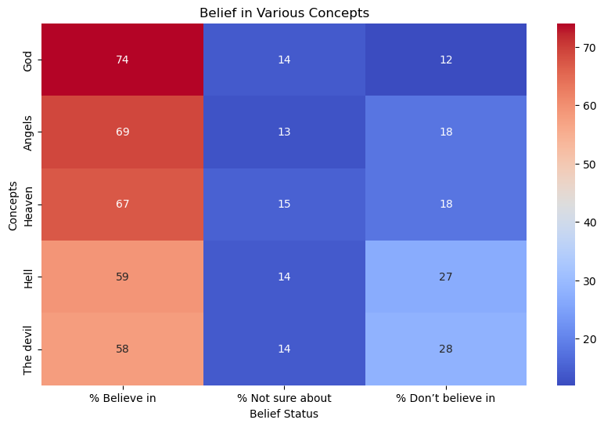
Heatmap

Slide 9



Summary
Secularism does not seem to be on the rise
Shock!

Slide 10
Thanks to
Sister Christian

Slide 11




Thank for Listening
Christian Ainscough
jaggling@gmail.com

